Slide 1
Data Operating Model
July 2021

Slide 2
Contents
0 – Strategic Drivers
1 – Capabilities Split
2 – Group IT Data Office Team and Roles
3 – Interaction Models
4 – BU & Entity Data Teams and Roles

Slide 3
0
Data Operating Model Strategic Drivers

Slide 4

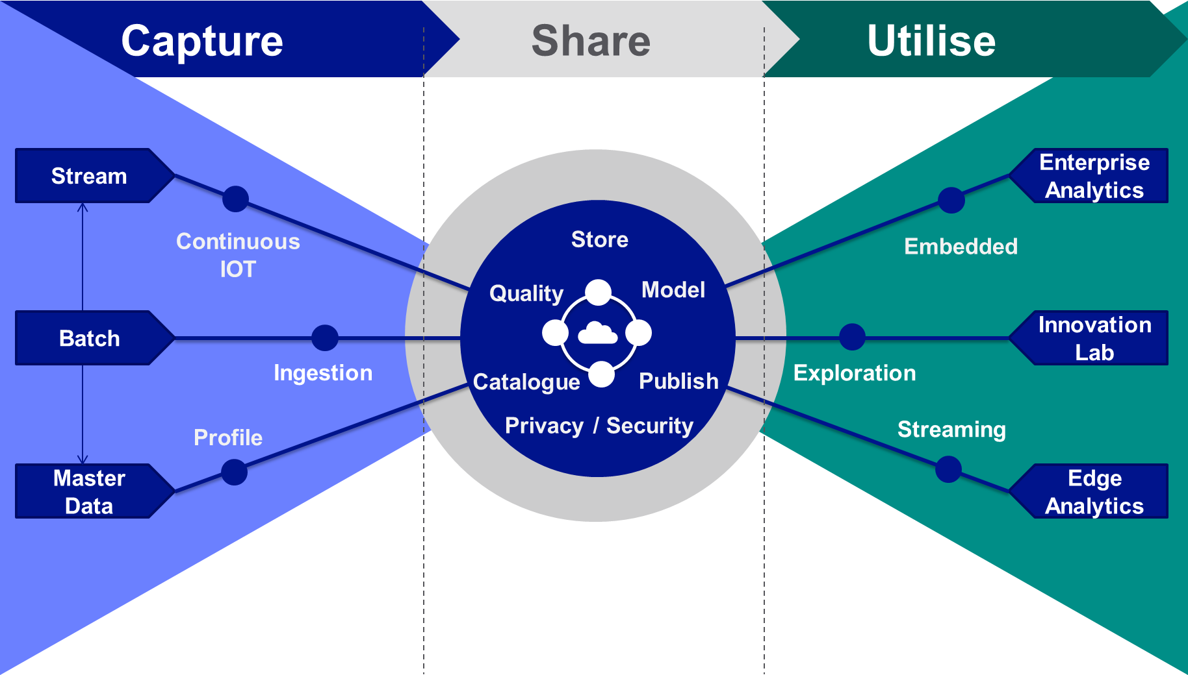

Group Data Strategy
Releasing value with data
What is the business imperative?
What are the challenges?
Data is critical for the success of the Digital Strategy:
engage our customers
improve asset health
help our employees perform
Our business units face common challenges, which we can solve collaboratively
Trust in data – Quality of data, data replication
Access to data – Siloes, tech proliferation
Value from data – Time to market
What will we do?
Value first approach (Right to Left thinking)
Capture: Manage data by mastering, cataloguing and cleansing
Share: Liberate data from source, enabling utilisation, securely
Utilise: Outcomes driven, incremental value. Innovation enabling

Slide 5
Group Data Strategy
How will we do this?
Capture:
Identify and prioritise master data issues across BUs and deploy Reltio to resolve
Use the Enterprise Data Platform to catalogue, manage, master and govern data
Utilise:
Implement a value first method to capture use case outcomes enabling incremental value releases
Follow a common analytics architecture to enable reuse, whilst supporting innovation
Digital MVPs – evolve to a data products approach
Share:
Establish the Enterprise Data Platform as the common repository for analytical workloads across the company by end FY23
Data privacy and security classifications built into data catalogue allowing for automated role based access

Slide 6








Group Data Strategy
How will we do this?
Data Operating Model
Global: IT Data Office
Entity: Business Unit / Function
Data Analytics Strategy
Promote and advance analytics culture, capability and strategy
Data Architecture
Promote and advance business enablement through data
Data Analytics
Effective generation of performance, operational & regulatory reporting
Data Science
Exploit data to generate insight and improve decision-making & operations
Group
Entity
Data Engineering
Deliver and maintain data solutions through data engineering
Data Governance & Assurance
Promote and advance data standards, culture and governance
Data Operations
Deliver improvements in data quality, cataloging and mastering
Data Governance
Promote and advance data standards, culture and governance
Group Operating Model – People & Process:
A Federated Data Strategy approach requires a hub and spoke organisation
The Target Data Operating Model will continue to evolve, and will learn from the Digital MVPs

Slide 7
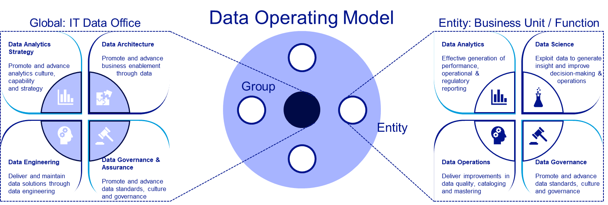
Group Data Strategy
How will we do this?
Group Operating Model – Delivery:
Group Data is set up to deliver data platforms and ‘Capture & Share’
BUs should establish capabilities to ‘Utilise’ and deliver value
This model is not the target, and will need to transition to a more ‘Digital’ model

Slide 8
1
Data Operating Model Capabilities

Slide 9
Group Operating Model Requirements
Strategic plans:
Drive incremental release of value whilst focusing on ‘capture’, ‘store’ and ‘utilise’.
A federated strategy to keep technologies and architectural designs common to enable cost efficiencies, reuse and synergies across the Group
Organisation Structure:
To enable a federated strategy, a hub and spoke set up is required to set and orchestrate a common strategy for technology and data architecture, which enables reuse of data & analytics solutions, design, code, processes and skills.
A central platform and solutions engineering team have been established to deliver enabling capabilities (platforms and tools) as well as ‘capture’ and ‘store’ data capabilities.
BUs and Digital Teams should ramp up to deliver ‘utilise’ data capabilities, however, the central data engineering team can also support this if the capability is not available.
Target Organisation:
As NG data capabilities mature, more activities should be taken on in the BUs. The Digital Accelerator programme will help with this and also shape how the BUs should reorg for Data (product basis).
BUs wanting to start this transition should start to consider their data operating model changes (roles and responsibilities) and agree a transition plan with Group Data Office and Data Engineering

Slide 10
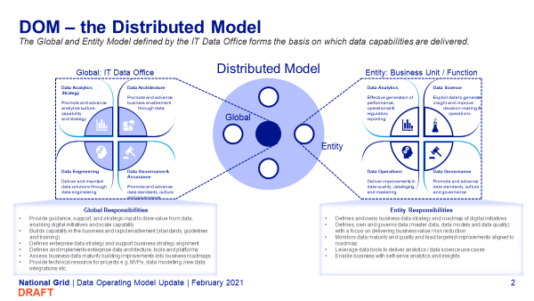
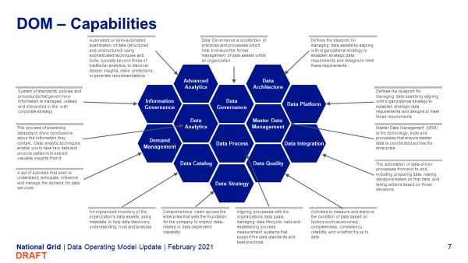
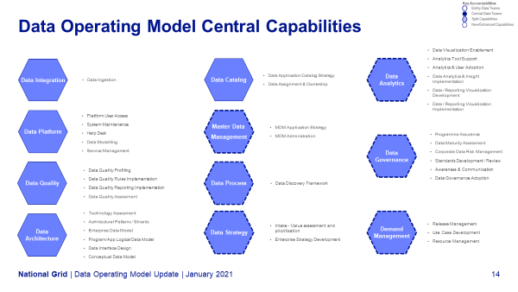
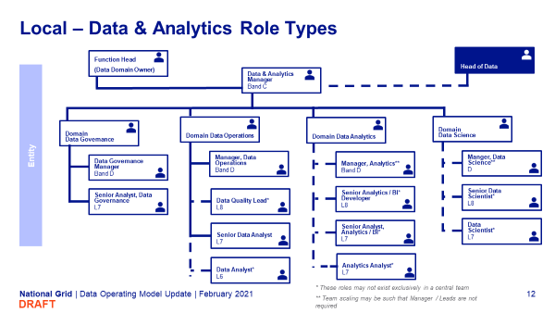
Data Operating Model (DOM) Structure
The DOM structure contains four tiers of capability split across the business and central data teams
The top tier of the Data Operating Model illustrates the overall split of teams between global and local and includes the high level areas of responsibility for each team
Accountabilities
Data Capabilities
The second tier of the DOM breaks down the global and local split into the capabilities required to deliver the T2 Portfolio. It includes the central view of where these capabilities are placed to deliver against the T2 requirements.
Data Activities
The third tier of the operating model splits illustrates the key activities for both the global and local teams that are contained within the capabilities.
Data Teams
The fourth tier of the DOM show cases the central view of the teams required to own the capabilities and associated capabilities. The Entity team has been designed based on generic requirements and would be expected to flex in line with the entity demand.
DRAFT

Slide 11
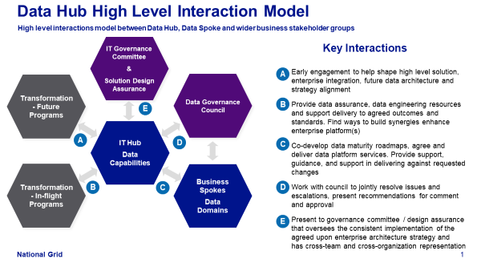
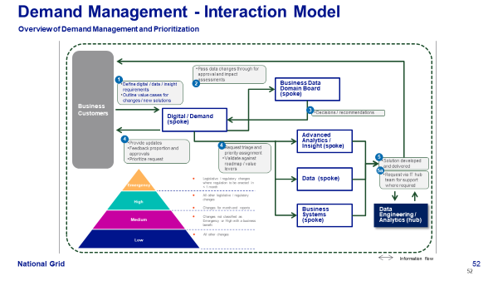
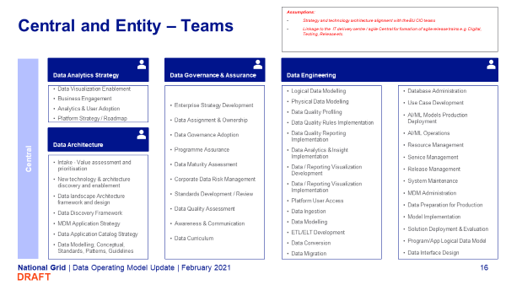
Data Operating Model (DOM) Processes
Supporting the tiers of the DOM are a series of processes that showcase how the entity and central data teams interact.
The first layer of processes within the DOM illustrates the key expected relationships between the different functions and teams that sit within the operating model.
Accountabilities
Data Capabilities
The second layer of processes expands upon interaction model and illustrates how the proposed capabilities and associated activities would operate between the global and local teams.
Data Activities
The third layer of processes calls out the expected activities that each team within the DOM would be accountable for.
Data Teams
DRAFT

Slide 12
DOM – the Distributed Model
The Global and Entity Model defined by the Group Data Office sets the basis for data capabilities definition and delivery
Distributed Model
Global: IT Data Office
Entity: Business Unit / Function
Data Analytics
Effective generation of performance, operational & regulatory reporting
Data Science
Exploit data to generate insight and improve decision-making & operations
Data Strategy & Utilise
Set, implement and federate Group Data Strategy
Drive value first data utilization for incremental value delivery
Drive analytics innovation and value exploration
Data Architecture & Share
Set, implement and federate Group reference architecture and strategy
Drive private, secure, data sharing
Global
Data Delivery & Digital WoW
Deliver and maintain data platforms
Delivery and maintain ‘capture and share’ data solutions
Drive Digital WoW evolution
Data Governance & Capture
Promote and advance data standards, culture and governance
Drive improvements in data at source to increase trust in data captured for analytics
Entity
Data Operations
Deliver improvements in data quality, cataloging and mastering
Data Governance
Promote and advance data standards, culture and governance
Areas for consideration:
Innovation and exploration – Group Data Science CoE
Areas for consideration:
IT & business roles – consumption and governance vs productionisation & Sup/Maint/Ops
DRAFT
Notes:
Final version of slide will contain descriptions for each DOM capability
Slide content to be peer reviewed
Include call out on how far DOM has been incorporated into the wider Op Model work

Slide 13
DOM – the Distributed Model
The Global and Entity Model defined by the IT Data Office forms the basis on which data capabilities are delivered.
Distributed Model
Global: IT Data Office
Entity: Business Unit / Function
Data Strategy
& Utilise Owner
Promote and advance analytics culture, capability and strategy
Data Architecture
& Share Owner
Promote and advance business enablement through data
Data Analytics
Effective generation of performance, operational & regulatory reporting
Data Science
Exploit data to generate insight and improve decision-making & operations
Global
Entity
Data Engineering
Deliver and maintain data solutions through data engineering
Data Governance & Assurance
& Capture Owner
Promote and advance data standards, culture and governance
Data Operations
Deliver improvements in data quality, cataloging and mastering
Data Governance
Promote and advance data standards, culture and governance
Global Responsibilities
Provide guidance, support, and strategic input to drive value from data, enabling digital initiatives and scale capability
Builds capability in the business and rapid enablement (standards, guidelines and training)
Defines enterprise data strategy and support business strategy alignment
Defines and implements enterprise data architecture, tools and platforms
Assess business data maturity building improvements into business roadmaps
Provide technical resource for projects e.g. MVPs, data modelling, new data integrations etc.
Entity Responsibilities
Defines and owns business data strategy and roadmap of digital initiatives
Defines, own and governs data (master data, data models and data quality) with a focus on delivering business value / risk reduction
Monitors data maturity and quality and lead targeted improvements aligned to roadmap
Leverage data tools to deliver analytics / data science use cases
Enable business with self-serve analytics and insights
DRAFT
Notes:
Final version of slide will contain descriptions for each DOM capability
Slide content to be peer reviewed
Include call out on how far DOM has been incorporated into the wider Op Model work

Slide 14
Teams/Capabilities Matrix
BRYAN – Do we need to synch up terminology with what we entered into Ehub?
Global: IT Data Office
Utilise & Data Strategy (& Data Science CoE)
Digital WoW & Data Engineering
Capture & Data Governance
Share & Data Architecture
2
Advanced Analytics
6
Data Architecture
1 Information Governance
5 Data Governance
10 Data Platform
2
6
2
2
6
2
6
1
2
5
10
1
5
10
1
5
10
1
5
10
9
1
9
3
4
8
3
3
4
8
13
3
4
8
9
13
3
4
13
4
Data Analytics
9
Master Data Management
3
7
8
12
7
7
12
12
11
11
11
11
3 Demand Management
8
Data Process
13 Data Integration
Entity: Business Unit
7
Data Catalog
12 Data Quality
11
Data Strategy
Utilise/Value & Data Strategy
Data Delivery & Operations (IT)
Data Governance
Utilise/Explore & Data Science
1
2
5
6
10
1
2
5
6
10
1
2
5
6
10
1
2
5
6
10
4
9
4
9
9
3
8
3
3
4
8
3
3
4
8
3
3
4
8
3
7
8
12
12
13
7
12
7
12
11
11
12
11
11
9
7
DRAFT

Slide 15
DOM – Capabilities
Automated or semi-automated examination of data (structured and unstructured) using sophisticated techniques and tools, typically beyond those of traditional analytics, to discover deeper insights, make predictions, or generate recommendations.
Data Governance is a collection of practices and processes which help to ensure the formal management of data assets within an organization
Defines the blueprint for managing data assets by aligning with organizational strategy to establish strategic data requirements and designs to meet these requirements
Advanced Analytics
Data Architecture
System of standards, policies and procedures that govern how information is managed, utilised and interpreted in line with corporate strategy
Information Governance
Data Governance
Data Platform
Defines the blueprint for managing data assets by aligning with organizational strategy to establish strategic data requirements and designs to meet these requirements
Data Analytics
Master Data Management
The process of examining datasets to draw conclusions about the information they contain. Data analytic techniques enable you to take raw data and uncover patterns to extract valuable insights from it
Demand Management
Data Process
Data Integration
Master Data Management (MDM) is the technology, tools and processes that ensure master data is coordinated across the enterprise.
Data Catalog
Data Quality
Data Strategy
The automation of data-driven processes from end-to-end, including preparing data, making decisions based on that data, and taking actions based on those decisions
A set of activities that seek to understand, anticipate, influence and manage the demand for data services
An organized inventory of the organization’s data assets, using metadata to help data discovery, understanding, trust and analysis
Comprehensive vision across the enterprise that sets the foundation for the company to employ data-related or data-dependent capability
Aligning processes with the organizations data goals, managing data lifecycle, risks and establishing process measurement systems that support the data standards and best practices
Activities to measure and improve the condition of data based on factors such as accuracy, completeness, consistency, reliability and whether it's up to date.
DRAFT
Notes:
BRYAN – we need to synch up terminology with what we entered into Ehub!
Final version of slide will contain descriptions for each DOM capability
Slide content to be peer reviewed
Include call out on how far DOM has been incorporated into the wider Op Model work

Slide 16
DOM – Accountability
A detailed RACI of the DOM capabilities outlines split of accountability between Central IT data teams and business data teams. This ensures that the correct level of accountabilities are defined and agreed, enabling the business units’ individual strategies
Advanced Analytics
Data Architecture
Information Governance
Data Governance
Data Platform
Data Analytics
Master Data Management
Demand Management
Data Process
Data Integration
Data Catalog
Data Quality
Data Strategy
Footnotes:
1. Tables shown represent a snapshot of the Full RACI
DRAFT
Notes:
Final version of slide will contain descriptions for each DOM capability
Slide content to be peer reviewed
Include call out on how far DOM has been incorporated into the wider Op Model work

Slide 17
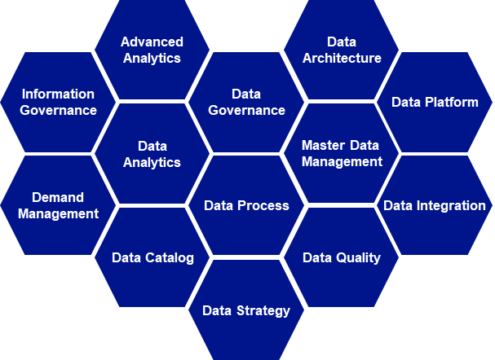
DOM – Alignment with Wider Functions
The Data Operating Model is planned to operate in conjunction with the wider entity IT units, as well aligning to the Digital Central that is concurrently being mobilised.
Data Operating Model
Supported Business Teams
BU CIO:
Alignment:
Business Strategy
Technology Roadmap
The capabilities and associated activities will integrate closely with the BU CIO team, specifically the linkage between Data Architecture, Data Strategy and Demand Management bringing in expertise from Domain Architecture
Digital Central:
Incubating:
Digital Products
Digital Enablers
Digital/Data Platforms
To support Digital initiatives lead by the Digital Central, there will be an alignment and support of capabilities between Data Architecture, Advanced Analytics, Data Strategy, Demand Management, Data Platform and Data Integration. Additional Digital Capabilities will equally support and compliment such as: Digital Methodologies & Ways of Working , Digital Talent & Culture and Comprehensive Digital Funding & Governance System*
Footnotes:
1. *These capabilities are called out in the work in progress NG Digital Operating Model
DRAFT
Notes:
Final version of slide will contain descriptions for each DOM capability
Slide content to be peer reviewed
Include call out on how far DOM has been incorporated into the wider Op Model work

Slide 18
2
Global IT
Data teams and roles

Slide 19

Global Data Team Overview
Assumptions:
Strategy and technology architecture alignment with the BU CIO teams
Linkage to the IT delivery centre / agile Central for formation of agile release trains e.g. Digital, Testing, Release etc.
Utilise & Data Strategy
Data Engineering & Digital WoW
Driving BUs to lead with Value (utilise)
Group & BU Data Strategy & Roadmap
Group Strategy Progress Reporting
Data Value Definition and Mapping
Data Maturity Assessments
Supplier Management
BU Data Collaboration & Comms
FY23: Data Science CoE
Driving a shift to Digital WoW for Data
Data Platform DevOps
Data Solution DataOps (Capture, Share)
Optional : Data Solution DataOps (Utilise)
Logical & Physical Data Modelling
Platform User Access
Data Ingestion, conversion, migration
ETL/ELT Development
Data Quality design and implementation
Data Analytics & Insight Implementation
Data / Reporting Visualization Implementation
Database Administration
Use Case Development
AI/ML Models Production Deployment
AI/ML Operations
Resource Management
Service Management
Release Management
System Maintenance
MDM Administration
Data Preparation for Production
Model Implementation
Solution Deployment & Evaluation
Program/App Logical Data Model
Data Interface Design
Share & Data Architecture
Capture & Data Governance
Driving BUs to Share data and reduce siloes
Intake - Value assessment and prioritisation
New technology & architecture discovery and enablement
Data landscape Architecture framework and design
Data Discovery Framework
MDM Application Strategy
Data Application Catalog Strategy
Data Modelling; Conceptual, Standards, Patterns, Guidelines
Driving BUs to Capture trustworthy data
Data Management Framework for IT Projects
Data Assignment & Ownership
Data Governance Adoption
Programme Assurance
Corporate Data Risk Management
Standards Development / Review
Data Quality Assessment
Data Curriculum
DRAFT

Slide 20
FY22 Workload Estimate
Some work is scalable with BU investment (# and size of projects), others are regular activities relating to maintaining either Group or BU data maturity levels
FY22 BU Investment:
US Electric: GridMod-DataManagement
US Customer: Customer Data Platform
UK ET: Data Lake Migration
Group: Digital MVPs (x2)
Global Functions HR: Workforce Data Domain
Regular activities eg:
Annual Group & BU Data Strategy & Roadmap refresh
BU Data Maturity Assessments (Quarterly)
BMS Data Management Standards (Quarterly)
Data Risk Management (Quarterly)
Data Comms and Literacy (Quarterly)

Slide 21
FY22 Workloads
 | Scalable | US Electric | US Customer | UK ET | HR-WDD | Digital MVPs | Total
Utilise | Data Value Mapping | 0.25 | 0.25 | 0.25 | 0.25 | 0.25 | 1.25
Share | Group Arch Alignment | 0.25 | 0.25 | 0.25 | 0.25 | 0.25 | 1.25
Capture | Data Governance Alignment | 0.25 | 0.25 | 0.25 | 0.25 | 0.25 | 1.25
Share | Conceptual Data Modelling | 0.25 | 0.25 | 0.25 | 0.25 | 0.25 | 1.25
 |  |  |  |  |  |  | 5
 | Regular | Q1 | Q2 | Q3 | Q4 | total
Utilise | BU & Group Strategy Update | 0.25 | 0.25 | 0.25 | 0.25 | 1
Utilise | Collaboration/Comms/Planning/Suppliers | 0.25 | 0.25 | 0.25 | 0.25 | 1
Utilise | Data Maturity Assessments | 0.25 | 0.25 | 0.25 | 0.25 | 1
Share | Technology review/assessments | 0.25 | 0.25 | 0.25 | 0.25 | 1
Share | Reusable reference architecture | 0.25 | 0.25 | 0.25 | 0.25 | 1
Capture | BMS Data Management Standards | 0.25 | 0.25 | 0.25 | 0.25 | 1
Capture | Data Risk Management | 0.25 | 0.25 | 0.25 | 0.25 | 1
Capture | Data Quality Assessments | 0.25 |  | 0.25 |  | 0.5
Total |  |  |  |  |  | 7.5
Above is copy and paste from here:

Slide 22
Global Data Team Role Types
N-3 Subfunctions
Head of Data
Snr Director,
Utilise & Data Strategy
Band C
Snr Director, Share & Data Architecture
Band C
Snr Director, Capture & Data Governance
Band C
Snr Director, Data Engineering & Digital WoW*
Band C
N-4 Roles
Senior Engineering Manager
Band D
Director, Data Value Analyst
Band C
Director, Information Architect
Band C
Senior Manager, Data Governance
Band D
Solutions Engineering Manager
Band D
Data Engineer
Band E / L8
Director, Data Value Analyst
Band C
Director, Information Architect
Band C
Principal Analyst, Data Governance
Band D
Data Architect
Band E / L8
Senior Solution Architect
Band E / L8
Data Comms and Planning
Band E / L7
Director, Information Architect
Band C
Senior Analyst, Data Governance
Band E / L7
Data Analytics Engineer
Band E / L7
Data Visualization Engineer
Band E / L7/L8
Footnotes:
This structure does not reflect complete sizing (i.e. number of roles) or team reporting lines
* Part of the Solutions Engineering Function
Database Administrator
Band E / L7/L8
AI/ML Operations Engineer
Band E / L7/L8
DRAFT

Slide 23
Global Roles & Responsibilities – Data Analytics Strategy
Central/Entity | Team | Role | Grade | Responsibilities
Global | Data Analytics Strategy | Director, Data Analytics | C | Leads and accountable for the execution of activities within the team Data Analytics strategy Business Engagement Analytics & User Adoption Platform Strategy & Roadmap
Global | Data Analytics Strategy | Senior Manager, Data Analytics | D | Business Engagement Analytics & User Adoption Technical Solutioning
Global | Data Analytics Strategy | Senior Data Visualization Engineer | D | Technical Solutioning Data Analytics Solutioning
Global | Data Analytics Strategy | Data Visualization Engineer | E / L7 | Data Analytics Solutioning
DRAFT

Slide 24
Global Roles & Responsibilities - Data Architecture
Central/Entity | Team | Role | Grade | Responsibilities
Global | Data Architecture | Senior Director, Information Architect | C | Leads and accountable for the execution of activities within the team Enterprise data strategy New technology & architecture discovery and enablement – 6 month to 5 year event horizon Develop target state enterprise information management capabilities Global and regional consulting support at program and project scope Business unit partnering
Global | Data Architecture | Director, Information Architect | C | Design data stewardship and governance architecture practices Optimize information flows and processes Define Master Data Management architecture New technology & architecture discovery and enablement – 6 month to 5 year event horizon Global and regional consulting support at program and project scope
DRAFT

Slide 25
Global Roles & Responsibilities - Data Gov & Assurance
Central/Entity | Team | Role | Grade | Responsibilities
Global | Data Governance & Assurance | Director, Data Governance | C | Leads and accountable for the execution of activities within the team Data strategy / roadmap Business unit partnering Enterprise data governance Data Management standard lead
Global | Data Governance & Assurance | Senior Manager, Data Governance | D | Data Standards user adoption Data maturity assessments and roadmaps Data assurance support
Global | Data Governance & Assurance | Principal Analyst, Data Governance | D | Data quality assessments Data governance and programme advisory Proof of concepts / Data impact assessments Data profiling and analysis
Global | Data Governance & Assurance | Senior Analyst, Data Governance | E / L7 | Data standards and guideline Data governance metrics Data controls and risk management Data communities and governance framework Data curriculum / Communications
DRAFT

Slide 26
Global Roles & Responsibilities – Data Engineering 1/2
Central/Entity | Team | Role | Grade | Responsibilities
Global | Data Engineering | Director, Data Analytics | C | Leads and accountable for the execution of activities within the team Data Platform & Engineering strategy Business Engagement Resource management Contract strategy
Global | Data Engineering | Senior Engineering Manager | D | Leads Data Engineering & Analytics activities for Projects/Programs for multiple business units Manages Data Engineering & Analytics team to implement Data solutions.
Global | Data Engineering | Solutions Engineering Manager | D | Leads Data Engineering & Analytics activities for Projects/Programs for a business unit Manages Data Engineering & Analytics team to implement Data solutions.
Global | Data Engineering | Data Engineer | D | Develop ETL/ELT Jobs for data extraction, transformation and load Implement and monitor jobs in production Develop SQL code Develop and implement IDQ rules Performance optimization. Data Platform Administration
DRAFT

Slide 27
Global Roles & Responsibilities – Data Engineering 2/2
Central/Entity | Team | Role | Grade | Responsibilities
Global | Data Engineering | Data Architect | Band E / L8 | Logical Data Modelling Physical Data Modelling Interface Data Design
Global | Data Engineering | Senior Solution Architect | Band E / L8 | Develops end-to-end data solution architecture Directs the data engineering team
Global | Data Engineering | Data Analytics Engineer | L7 | Data Analytics & Insight Implementation Data / Reporting Visualization Development Data / Reporting Visualization Implementation
Global | Data Engineering | Data Visualization Engineer | L7/L8 | Power BI Reports/Dashboards development Tableau Reports/Dashboards development
Global | Data Engineering | Database Administration | E/L7/L8 | Database Administration Support Data Platform Administration
Global | Data Engineering | AI/ML Operations Engineer | E/L7/L8 | Deploy and Monitor AI/ML Models in production
DRAFT

Slide 28
3
Interaction Models

Slide 29
Data Central High Level Interaction Model
High level interactions model between Data Central, Data Entity and wider business stakeholder groups
IT Governance Committee
&
Solution Design Assurance
Key Interactions
A
Early engagement to help shape high level solution, enterprise integration, future data architecture and strategy alignment
Provide data assurance, data engineering resources and support delivery to agreed outcomes and standards. Find ways to build synergies enhance enterprise platform(s)
Co-develop data maturity roadmaps, agree and deliver data platform services. Provide support, guidance, and support in delivering against requested changes
Work with council to jointly resolve issues and escalations, present recommendations for comment and approval
Present to governance committee / design assurance that oversees the consistent implementation of the agreed upon enterprise architecture strategy and has cross-team and cross-organization representation
Transformation - Future Programs
Global Data Governance Council
E
B
IT
Data Office (Central)
A
D
C
Transformation - In-flight Programs
Business Unit / Function Data & Analytics (Entity)
B
C
D
E
DRAFT

Slide 30
Demand Management - Interaction Model
Key Accountabilities / Responsibilities
Local / Entity
Overview of Demand Management and Prioritization
Global
Business Customers
a
2
b
Use Case Development
Pass data changes through for approval and impact assessments
1
a
Business Data Domain Board
Define digital / data / insight requirements
Outline value cases for changes / new solutions
b
Work Planning and Prioritization
Demand
3
a
c
Decisions / recommendations
Benefits Tracking
4
b
Advanced Analytics / Insight
d
Provide updates
Feedback proportion and approvals
Prioritize request
4
b
c
Release Management
Request triage and priority assignment
Validate against roadmap / value levers
5
d
e
f
Solution developed and delivered
e
Data
5a
Use Case Development
Request via IT Central team for support where required
f
Resource Management
Business Systems
Data Engineering / Analytics
Information flow
DRAFT

Slide 31

Advanced Analytics - Interaction Model
Key Accountabilities / Responsibilities
Local / Entity
Overview of Advanced Analytics, Data Science and Unstructured Data Capabilities
Global
Business & Data Analysis
a
b
1
Opportunity identified and request made
Business Customers
Data Preparation for Prototype
Digital / Demand
c
2
a
6
b
c
AI/ML Modelling
Identify high level advanced analytics requirements / objectives
Validate against roadmap / value levers
4
a
Explore and analyze the data
Create and test advanced models
Data preparation & prototyping
Define requirement
Identify data sources
d
Data Ingestion
Advanced Analytics / Insight
e
5
d
3
g
AI/ML Models Production Deployment
Data acquisition and loading into data platform
f
Tool selection for advanced analytics, AI and machine learning
Request for IT support where required
f
Service Management
7a
e
7b
f
Enterprise Architecture
Model deployment into production
Model monitoring
Platform Administration (inc Access management)
g
Data Engineering / Analytics
Solution Deployment & Evaluation
Information flow
DRAFT

Slide 32
Data Analytics - Interaction Model
Key Accountabilities / Responsibilities
Local / Entity
Overview of Reporting, Business Intelligence and Insight capability interactions
Global
a
i
Data Analytics & Insight
Analytics Tool Support
Business Customers
b
j
Data / Reporting Visualization
Analytics & User Adoption
11
d
a
d
1
a
c
k
New insight & reporting available
Opportunity identified and request made
Data / Reporting Visualization Definition
Data Analytics & Insight Implementation
2
a
Change pipeline issued for review / assessment
Business Data Domain Board
Digital / Demand
d
l
Regulatory Reporting
Data / Reporting Visualization Development
3
5
c
Analyst / Developer assigned to request
High level requirements / Impact assessment
e
m
Data Preparation for Production
Data / Reporting Visualization Implementation
b
d
6
a
Analytics / Insight
Risk / Impact assessment solution
f
8
i
4
c
Model Implementation
Request for support / release
Develop functional requirements
IT Data Team
Data
7
a
g
9
e
g
l
m
Prepare solution for UAT, evidence and Sign off
Solution Deployment & Evaluation
IT Release process
8a
f
g
h
10
j
Wider solution engineering support
Training and user adoption support
h
Business Systems
Data Visualization Enablement
Information flow
DRAFT

Slide 33
Data Catalog - Interaction Model
Key Accountabilities / Responsibilities
Local / Entity
Overview of metadata curation interactions
Global
Meta Data Management
a
Data Application Catalog Strategy
b
5
a
1
b
Maintain data in the data catalog
3
a
Understand requirements and define strategy
Collate Metadata from all sources
Data Governance
Data Governance
Data Assignment & Ownership
c
Enterprise Architecture
2
b
6
c
Tool selection
4
c
Administer the platform
Organize, store and publish metadata
Data Engineering
Information flow
DRAFT

Slide 34
Data Governance - Interaction Model
Key Accountabilities / Responsibilities
Local / Entity
Enterprise to domain view of Data Governance capability interactions
Global
Data Standards Implementation
a
f
1. Executive Steerco / Transformation Board)
Data Maturity Planning
b
Approve/communicate DG Strategy
Mediate/communicate
Escalated conflict resolutions
Escalated cross domain data resolutions
e
c
Escalate data related conflicts as needed
Data Change Process Management
f
g
h
i
j
k
Identify /document requirements for ongoing operations of the DGC
Provide ongoing non technical support
Provide impact analysis as needed
Prioritize requests, drafts recommendations
Provide consolidated reports with respect to DG performance
Communicate resolutions
2. Data Governance Council
Data Comms and Governance Awareness
d
Provide ongoing IT support to DGC
Data Issue Management
e
a
b
d
e
c
e
Review cross domain level Strategies
Communicate DG vision & objectives across the domains
Review cross domain data standards / definitions / policies / processes
Mediate conflict resolutions
Submit domain requests as needed
Provide appropriate representation when required
Escalate data conflicts
f
Programme Assurance
Data Governance
Data Architecture / Data Engineering
g
Provide ongoing IT support to the DGO
Provide tools, assists on queries required to assess the state of DG
Data Maturity Assessment
a
b
h
Provide Domain specific reports with respect to Data Governance performance
Provide tools, mechanisms, required for Business Domain to implement approved requests
Corporate Data Risk Management
Data Governance
d
g
k
i
Facilitate cross Data Domain discussions and escalation to DGC
Assign root cause analysis
Standards Development/ Review
d
a
b
j
Define data requirements
Communicate and provide education on the importance of Data Quality
Data Producers / Consumers
Create, update, and delete data in accordance with BMS standards and policies
Awareness and Comms
k
Data Governance Adoption
Information flow
DRAFT

Slide 35
Data Strategy - Interaction Model
Key Accountabilities / Responsibilities
Local / Entity
Overview of data and digital strategy development and interaction
Global
a
Strategy Development
Business Strategy
6
c
Strategy Delivery Plans incorporate data feedback
Data Operating Model
b
Provide Longer term Business priorities and data requirements
Enterprise Strategy Development
3
b
Data Engineering
Roadmap / Program Alignment
Data Architecture / Engineering
c
Intake Value Assessment
1
a
b
d
8
Feedback into Enterprise data strategy
Develop Business Data Strategy
4
c
Data Literacy & Comms
Service Delivery Management
Value Case Development
Data Governance
7
d
Data Governance
2
a
Leadership Engagement
Develop Entity Data Strategy
5
d
Data Curriculum & Culture
Information flow
DRAFT

Slide 36



Data Architecture - Interaction Model
Key Accountabilities / Responsibilities
Local / Entity
Overview of data and digital strategy development and interaction
Global
a
Business Customers
Data Integration
Data Science
Insight
1
Data Catalog
Provide data requirements
b
6
Update Data Catalog
Technology Assessment
Data
Publish data architecture strategy
Domain Data (Entity)
c
1
Provide data architecture requirements (models & tooling)
Architectural Patterns /Standards
1
Provide data model requirements (models)
Distribute and deliver metadata to authorized users and applications
7
d
Enterprise Data Model
1C. Provide data model requirements (models)
Data Architecture
Train up on enterprise conceptual & logical data model
Data Engineering (Global)
3
Data Engineering
Programme/ App Logical data model
e
3
Update Data Catalog
8
e
5
4
f
Create & maintain enterprise conceptual & logical data model
Data Model
Maintain the logical and physical data models to ensure its relevancy and accuracy
Create target database specific physical data model
Extend / enhance enterprise data model to create project specific logical data model
Data Interface Design
3
g
Conceptual Data Model
2
b
9
e
Select enterprise data modelling tool
Data Modelling Tool
Operate and administer the data modelling platform
2
Onboard onto data modelling tool
Information flow
DRAFT

Slide 37
Data Platform - Interaction Model
Key Accountabilities / Responsibilities
Local / Entity
Overview of data and digital strategy development and interaction
Global
Business Customers
Platform User Access
a
1. IT Governance Board
Data
System Maintenance
b
Understand requirements and define strategy, including backup, recovery, archiving, etc.
e
c
Operate and administer the EDW and database platforms, including access management
Perform all DevOps activities
Help Desk
c
Perform database backup, recovery, and archival activities
Data Engineering
Database Administration
Data backup, Recovery & Archiving activities
Platform Monitoring
DevOps & Administration
d
Data Modelling
a
b
Data Governance
Perform Database Administration activities
Monitor and resolve databases and platform
Service Management
e
Data Architecture
Select the enterprise data warehouse platform
d
Create and maintain enterprise data platform architecture
Information flow
DRAFT

Slide 38
Data Integrations - Interaction Model
Key Accountabilities / Responsibilities
Local / Entity
Overview of data integration and orchestration interaction models
Global
Data Ingestion
a
Business Customers
1. IT Governance Board
Data
Understand requirements and define strategy
Define and implement cleansing, transformation and aggregation rules into the integration process
Acquire data from the source systems and “stage” them.
Schedule and Monitor data integration jobs
a
Data Engineering
Acquire
Migrate, Move or Convert
Implement
Load
Schedule & Monitor
Administer
Move, migrate and/or convert data.
Load the data into the data platform (EDW, Data Lakes, ODS, database, etc.)
Operate and administer the platform
Data Governance
Select the enterprise data integration and orchestration tool
Data Architecture
Create source-to-user data flow architecture
Information flow
DRAFT

Slide 39
Information Governance - Interaction Model
Key Accountabilities / Responsibilities
Local / Entity
Overview of Information Governance capabilities and interactions
Global
Archiving and Retention
a
Business Customers
a
Set roadmap / strategy
Define data retention schedule
Reference business glossary and publication schedules
Annual Planning & Quarterly Rolling Forecast Support
b
Data Governance
Advanced Analytics / Insight
Performance Reporting
c
b
Data collation / preparation
Set / Agree success metrics
c
KPI models / scorecards
b
c
Performance framework updates
a
b
Updates to system archiving rules / policies
Financial models / reports
Data Engineering
Data
Information flow
DRAFT

Slide 40
Data Process - Interaction Model
Key Accountabilities / Responsibilities
Local / Entity
Overview of data process and systems change interactions
Global
Data Analysis
a
Business Customers
c
Create Data Process Framework and Strategy
Data Architecture
Data Process Mapping
b
Transformation Initiatives
Data Discovery Framework
c
Data Engineering
Data Governance
a
Data
Systems Management
b
Process Management
Process Quality Assurance Controls
System change and master data maintenance
Alignment to data architecture / models
Risk Management
Process Quality Assurance Controls
Data Impact Assessments
Data Analysis
Information flow
DRAFT

Slide 41
Master Data Management - Interaction Model
Key Accountabilities / Responsibilities
Local / Entity
Overview of data and digital strategy development and interaction
Global
4
Appoint data owners and stewards
Master/ Reference Management
a
Business Customers
1
c
Data
Understand requirements and define MDM strategy
2
b
b
Identify master data and evaluate sources
Master Data Impact Assessments
MDM Application Strategy
c
Data Governance
6
b
Identify modifications to be made
MDM Administration
d
4
Select architecture and data models
3
Data Architecture
Analyse metadata and data lifecycles
5
Select the enterprise MDM tool
10
d
Administer the MDM platform
7
Develop prototypes
9
a
Data Engineering
8
Maintain master data
Develop and implement full solution
Information flow
DRAFT

Slide 42
Data Quality - Interaction Model
Key Accountabilities / Responsibilities
Local / Entity
Overview of data and digital strategy development and interaction
Global
a
Data Quality Profiling
Business Customers
b
1
b
e
g
h
Data Quality Improvement Programme
c
d
Understand requirements and define strategy
Data Governance
Data
c
Data Quality Rules Definition
3
a
7
d
Profile and Analyse source data
Review exceptions and plan remediation or rule refinement
Data Quality Reporting Definition
4
8
2
b
Establish metrics and define targets
Monitor data quality versus targets
Data Governance
Select the enterprise data quality tool
e
5
f
Data Quality Profiling
Define and implement rules in DQ tool
6
f
Data Quality Rules Implementation
f
Define and implement audit rules into integration processes
Data Engineering
Data Architecture
g
Data Quality Reporting Implementation
9
Operate and administer the platform
Data Quality Assessment
h
Information flow
DRAFT

Slide 43
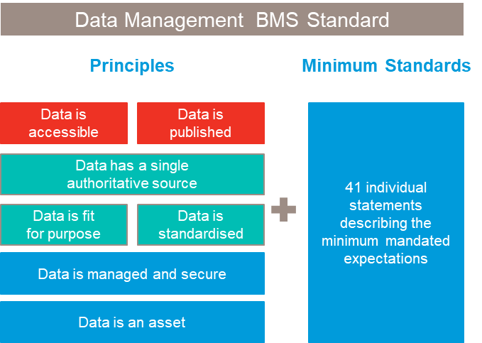
Data Governance Framework
Data Governance is the overarching policies and processes that govern the management of enterprise data assets
Our goals are:
Data Management standards are embedded into our day to day operations
Data is managed as a strategic asset and is clearly defined and owned
Common terminology adopted for our master data
Appropriate controls and processes operating for data management
Data quality is being actively managed and quality improved
Multi-Entity (Facilitated by Central)
Data Governance
Executive Data Governance Council (EGC)
1% of Decisions
Data Governance Council
(DGC)
5% of Decisions
Domain Data Governance Board (DGB)
Data Domain Owner
Decision Path
Data Stewardship
Escalation Path
Business
Data Steward
Business
Data Steward
Data Owner
Doman Data Steward Consultations
(DSC)
94% of Decisions
Business
Data Steward
Business
Data Steward
Data Stewards
Business
Data Steward
Business
Data Steward
Data Specialists
Entity
| Data Operating Model Update | February 2021
DRAFT

Slide 44
4
Entity Business
Data teams and roles
Business roles and team represented to show alignment to IT teams and does not reflect actual org designs within al; the business units / functions

Slide 45

Entity Data Team Overview
Assumptions:
Strategy and technology architecture alignment with the BU CIO teams
Business System Ownership clearly defined and processes in place to manage change and links to data work
Digital product ownership in place to support value case development and digital initiative linkage to data
Domain Data Governance
Domain Data Operations
Domain Data Analytics
Domain Data Science
Data Change Process Management
Data Communication and Governance Awareness
Data Standards Implementation
Data Issue Management
Data Maturity Planning
Archiving & Retention
Meta Data Management
Data Analysis
Data Process Mapping
Data Integration
Master / Reference Management
Data Quality Improvement Programme
Data Quality Profiling*
Data Quality Rules Definition*
Data Quality Reporting Definition*
Strategy Development
Data / Reporting Visualization Requirements & Definition
Advanced visualization development / self service enablement
Data Analytics & Insight*
Benefits tracking*
Data / Reporting Visualization*
Regulatory Reporting*
Business & Data Analysis*
Data Preparation for Prototype *
AI/ML Modelling *
Alignment to digital initiatives*
* These activities may not exist exclusively in a central team and be democratized within the business
DRAFT
DRAFT

Slide 46
Entity Data Team Role Types
Function Head
(Data Domain Owner)
Head of Data
Snr Director, Data & Analytics
Band C
Data Governance Roles
Data Operations Roles
Data Analytics Roles
Data Science Roles
Manager, Data Governance
Band D
Manager, Data Operations
Band D
Manager, Analytics**
Band D
Manger, Data
Science**
D
Senior Analyst, Data Governance
L7
Data Quality Lead*
L8
Senior Analytics / BI* Developer
L8
Senior Data
Scientist*
L8
Senior Data Analyst
L7
Senior Analyst, Analytics / BI*
L7
Data
Scientist*
L7
Footnotes:
This represent the roles expected to reside in the business / business data teams
This structure does not reflect complete sizing (i.e. number of roles) or team reporting lines ** Team scaling may be such that Manager / Leads are not required
* These roles may not exist exclusively in a central team
Data Analyst*
L6
Analytics Analyst*
L7
DRAFT

Slide 47
Entity Roles & Responsibilities
DRAFT
Central/Entity | Team | Role | Grade | Responsibilities
Local | Data Management | Data & Analytics Manager | C | Leads and accountable for the execution of activities within the team Data & digital strategy / roadmap Business unit partnering
Local | Data Governance | Manager, Data Governance | D | Data standards user adoption Data maturity assessments and roadmaps Domain data governance / risk management
Local | Data Governance | Senior Analyst, Data Governance | L7 | Data governance metrics Data communities / Data steward working groups Data curriculum / Communications
Local | Data Operations | Data Manager | D | Data strategy Data change management Data lifecycle management
Local | Data Operations | Data Quality Lead | L8 | Data quality improvement programme Data quality rule definition Data quality advisory
Local | Data Operations | Senior Data Analyst | L7 | Meta data management / Master data impact assessment Data process mapping Data model ownership
Local | Data Operations | Data Analyst | L6 | Data quality rules & reporting Data profiling / analysis

Slide 48
Entity Roles & Responsibilities
DRAFT
Central/Entity | Team | Role | Grade | Responsibilities
Local | Data Analytics | Manager, Analytics | D | Insight / Analytics strategy development Demand management Use case development / prioritisation
Local | Data Analytics | Senior Analytics / BI Developer | L8 | Creation of self-serve reports Development of end user insights
Local | Data Analytics | Senior Analyst, Analytics / BI | L7 | Creation of self-serve reports BI / Visualization requirements gathering End-user support and adoption
Local | Data Analytics | Analytics Analyst | L7 | Legislative and regulatory reporting and analysis Data analysis & opportunity identification Benefits tracking
Local | Data Science | Manager, Data Science | D | Insight / Analytics strategy development Demand management Use case development / prioritisation
Local | Data Science | Senior Data Scientist | L8 | Data analysis & opportunity identification Data ingestion / modelling Application of advanced analytical / statistical techniques Prototyping / Innovating new solutions
Local | Data Science | Data Scientist | L7 | Data analysis & opportunity identification Data ingestion / modelling Prototyping / Innovating new solutions

